Slide 1

Cricket Performance Analysis Dashboard
Transforming raw cricket statistics into meaningful insights through data analysis and visualization

Slide 2



Project Overview
Exploratory Data Analysis
Interactive Dashboard
Performance Insights
Clean and preprocess raw cricket datasets to extract meaningful patterns
Streamlit-based interface for real-time player performance comparison
Visualize metrics like strike rate, batting average, and country-wise data

Slide 3

Problem Statement
Data Challenges
Cricket performance data is scattered across sources and difficult to interpret directly
Manual comparison is time-consuming
Raw data lacks structure
Lack of accuracy in player evaluation
Difficult to extract actionable insights

Slide 4
Project Objectives
01
02
Data Preprocessing
Exploratory Analysis
Clean and structure raw cricket datasets
Perform comprehensive EDA on player statistics
03
04
Visualization
Dashboard Development
Build interactive charts for performance metrics
Create user-friendly interface for easy comparison

Slide 5
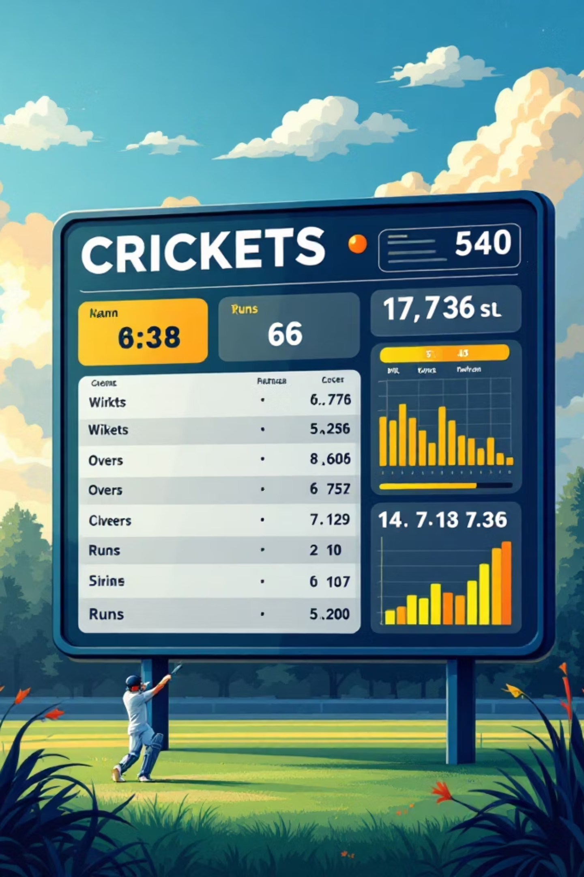
Dataset Description
Player Statistics
Runs, strike rate, batting average, and wickets
Country-wise Data
Performance metrics grouped by nation
Batting Records
Aggressive vs consistent playing styles analysis

Slide 6






Methodology Workflow
Data Collection
Gather raw datasets
Data Cleaning
Preprocess and validate
EDA
Explore patterns
Visualization
Build charts
Dashboard
Deploy interface
Insights
Generate findings

Slide 7




Key Features
Interactive Player Search
Country-wise Filtering
Quickly find and analyze specific players with real-time data retrieval
Compare performance metrics across different nations and regions
Performance Comparison
Data Visualization
Benchmark players using strike rate, average, and consistency metrics
Interactive charts and graphs for intuitive understanding of complex statistics

Slide 8

Key Insights
Top Performers
Cross-Country Analysis
Identified elite players based on strike rate, batting average, and consistency metrics
Discovered performance trends and country-specific playing styles
Style Comparison
Analyzed aggressive versus consistent batting approaches and their effectiveness

Slide 9
Tools & Technologies
Python
Pandas & NumPy
Core programming language for data analysis
Data manipulation and numerical computing
Matplotlib & Seaborn
Streamlit
Statistical visualization libraries
Framework for interactive dashboard development

Slide 10
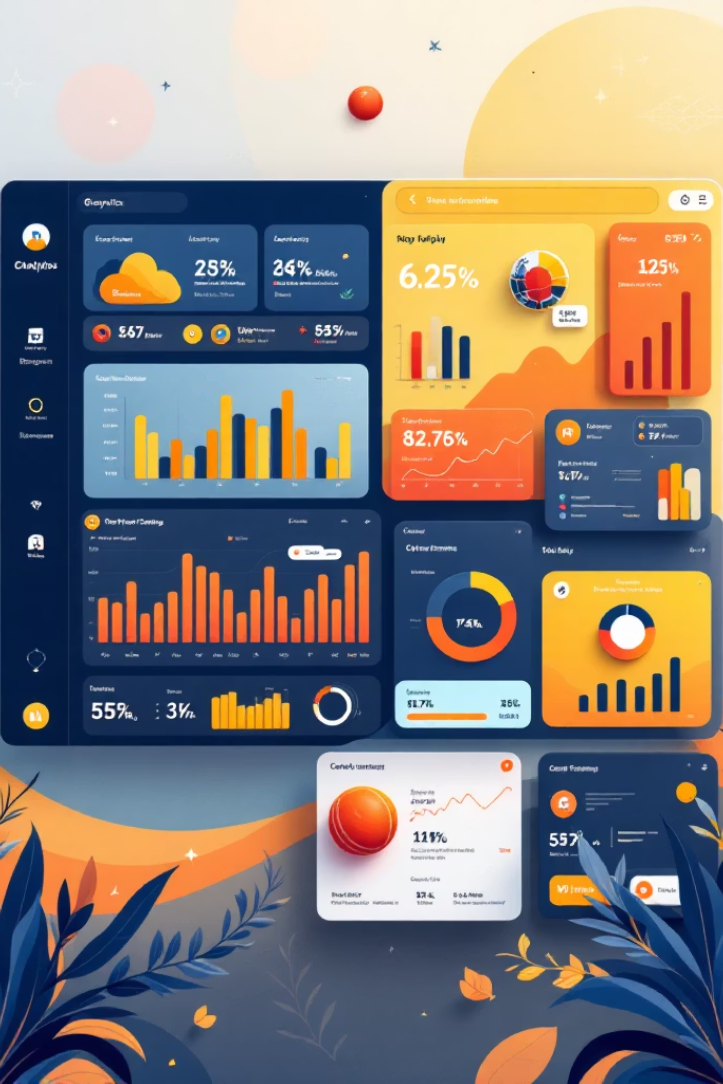
Project Outcome
Transformed Raw Data
Enhanced Understanding
Converted scattered statistics into actionable insights
Enabled better comprehension of player performance through visualization
Real-world Application
Demonstrates strong skills in data analysis, visualization, and problem-solving
Thank you
Beesam Gayathri

